Slide 1
Practice Lab:
This Practice Lab has no specific preceding Discussion Unit.
In this Practice Lab, members of the class each create one node that will belong to a single DSE cluster.
Instructions in this practice lab are written for CentOS 7 using the command line, but should function for most Linux distros.
DSE Cluster Creation
Notes:
The goal of this Practice Lab is to experience creating a DSE cluster.
Further: Dive deep into configuration files and understanding what changes and is important for cluster configuration Cluster, Data Center and rack names will be shared so you can set up your own machine.

Slide 2


Challenge: Create a DSE Cluster
Prerequisites:
That each attendee is on the same subnet
-- We are likely using non route-able private network addresses
-- That means your node must be on
your base OS. Else, you are
responsible for figuring out port
forwarding/similar; (not the fastest path)
All work done as ‘root’
Instructor, 1 Node
June, 1 Node
Alice, 1 Node
Mary, 1 Node
Dave, 1 Node
Notes:
Each attendee will create one DSE node, that is to connect to a single DSE cluster
Reference Urls:
http://www.steves-internet-guide.com/internal-external-ip-addresses/

Slide 3
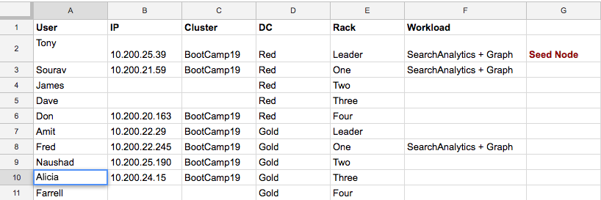
Challenge: Create a DSE Cluster, You will receive a spreadsheet
Notes:
Comments relative to this challenge:
The instructor has already created a single node cluster with multiple data centers and racks.
You will receive instructions (likely via a spreadsheet) with the cluster name, and IP address of the one existing node.
These instructions will include whatever data you should include in the creation of your one node, that is to join the cluster; data center name, rack, other.

Slide 4
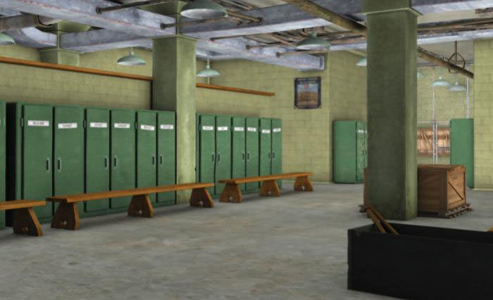
Challenge 1: You are done When ..
You are done when:
nodetool reports that you have joined the cluster and are healthy; you're balanced, other
Feel free to communicate with other attendees. If a Slack channel is available for the class, use Slack/other.

Slide 5

Practice Lab:
Lessons Learned
Notes:
Discuss what worked well, poorly, from the Practice Lab.
Further:
What does the default snitch do?
What issues did you run into?
Do you know why they were issues?
How would you handle changes like in the exercise in a production system?
Look at the data in the tables system.local and system.peers

Slide 6
Notes:
End of Practice Lab-

